Slide 1
UNWOMEN/IPEN Transformative Mixed Methods Evaluation:
Day 2 Quantitative & Qualitative Methods
Prof. Donna M. Mertens
Gallaudet University
Almaty, Kazakhstan
July 2011

Slide 2
Three days together
Day 1: What is the role of the evaluator?
Overview of evaluation (Terms of Reference)
Transformative paradigm
Diversity & social justice; privilege
Cultural competence
Day 2: Quantitative & qualitative approaches
Day 3: Mixed methods approaches

Slide 3
Mixed Methods
Understanding mixed methods requires understanding both quantitative and qualitative methods.
Then it becomes something like a Chinese menu: Take one from column A and one from column B
With a bit of complexity thrown in as to how the methods will be integrated.

Slide 4
Methods Options
Quantitative approaches such as experimental, quasi-experimental, survey, and comparative designs
Qualitative approaches such as group processes (e.g., focus groups or some indigenous methods), case studies, ethnographic research, phenomenological research, and PAR
Gender analysis is a mixed-methods approach that provides a framework for transformative research and evaluation that has potential for transfer to other groups that experience discrimination.
Mixed methods are most likely to be the approach of choice because of the need to integrate community perspectives into the inquiry process, thus necessitating collection of qualitative data during the research or evaluation process. (Mertens, 2009, TRE, p. 165).

Slide 5
Considerations when choosing a design and data collection strategies
What are the skills of your evaluation team?
What resources/data are available?
What kind of methods do the stakeholders want?
How reliable/valid is your data collection method for the evaluation?

Slide 6
Experimental EVALUATION DESIGN
Experimental
Quasi Experimental
Non Experimental (Single Group)
6
Notes:
EVALUATION DESIGN
We have earlier (yesterday) discussed differed evaluation types. Recall we looked at evaluation which focuses on a project or a programme. There are evaluations which are external or internally conducted. And then we spoke about when an evaluation is conducted differentiates its type – formative during and intervention and summative at the conclusion of the intervention. We can mix these – have an external, formative evaluation of a policy for example.
We have just reviewed some models and theories, and again you saw there are variations and importantly real life evaluation often draws from different models to achieve its ends. Now we are going to talk about the design of evaluation – and there are three distinct designs:
Experimental
Quasi Experimental
Non Experimental
Let’s take a look at what each of these are.

Slide 7
EXPERIMENTAL DESIGN
Links between interventions and observed outcomes
Treatment and Control Groups
Random Assignment
7
Notes:
EXPERIMENTAL DESIGN
Experimental designs or random controlled trials (RCT) are seen as very scientific, factual and therefore in some circles as the best option in design. Think here about the pharmaceutical industry and what they do in testing new medications as they are developed – clinical or drug trials are perhaps the most widely known experimental designs. In those cases the new drug is given to some patients and a placebo is given to others to see the differences in health. Example of blind and double blind RCT, where recipients do not know what they are taking and when recipients and the people running the test do not know which medication / placebo is being given to whom.
Links between interventions and observed outcomes - The researchers are looking to see if the new drug results in better health outcomes than an old drug or a placebo (sugar pill with no real substance) – test attribution.
Treatment and Control Groups – there needs to be a group getting the medication and a group not getting it – purposefully. This means at the beginning of the programme there needs to be a decision to withhold the intervention to a group of potential recipients. Notice that this makes an experimental evaluation design dependant on the design of the programme – must be done up front as you start your programme. Also, what implications do you withholding programme benefits might have for development work generally and for HR and GE responsive evaluation? Can you see any ethical issues at play here?
Random Assignment – is also essential to an experimental design. Random means there must be an equal chance of being selected or not being selected – sort of like lotteries. In drug trials, all the sick patients must have an equal chance of being selected for the new drug and there are blind and double blind approaches – where the patient and or the researcher is not aware of who is taking which pill. This is to avoid possible bias in analyzing the results or demonstrating change.
Experimental designs, as you can see are very difficult to do in evaluation for these reasons. However, there are those who promote its use as the best method to be sure the programme activities were the real cause of the change. Let’s look at the other two options – quasi experimental and non experimental.

Slide 8
“Gold Standard” Debate
RCTs described as the ‘most pure’ evaluation design, providing credibility and validity
  Questions the value of qualitative methods
  Ethical issues
  Practical considerations (notably scale and data sources) to random selection
  Economic and time constraints
Notes:
US Dept of Ed “Scientifically Based Evaluation Methods” policy ( RCTs) at the Institute of Educational Sciences [www.ed.gov/programs/edresearch/applicant.html] and the Poverty Action Lab, MIT: RCTs as “the gold standard in evaluation…” initiated and perpetuated a debate over the respective value of different evaluation designs – concluding that RCT was the ‘gold standard’
This had been a hotly contested issue within the evaluation community and it is important for you t be aware that there are those who promote RCTs as the best of all evaluation designs. However, there are also those who dismiss this notion – including the American Evaluation Association who indicate “…RCTs are not always best for determining causality and can be misleading. RCTs examine a limited number of isolated factors that are neither limited nor isolated in natural settings. The complex nature of causality and the multitude of actual influences on outcomes render RCTs less capable of discovering causality than designs sensitive to local culture and conditions and open to unanticipated causal factors.” (2003). Source: www.eval.org
Conditions for which randomized control trials (RCTs) are especially appropriate (as presented by Michael Quinn Patton in 2005 [http://www.ifc.org/ifcext/sme.nsf/AttachmentsByTitle/MERandomizedControls.pdf/$FILE/MERandomizedControls.pdf ]
A discrete, concrete intervention
(treatment) – singular, well-specified
Implementation can be standardized
Implementation can be controlled
Valid and reliable measures exist for
the outcome to be tested
Random assignment is possible
Random assignment is ethical

Slide 9
QUASI EXPERIMENTAL
Treatment and Comparison groups
No Random Assignment
Matching, cross section, time series, longitudinal
Module 2-2
9
Notes:
QUASI EXPERIMENTAL
Treatment and Comparison groups – here we also use comparison groups, but these may not have been selected at the outset of the programme, they are not ‘control groups’. One might see comparison groups like a village who did not get the new wells or new road being examined in the evaluation to see what changes happened in the absence of the programmme or intervention. In this way we can often account for some changes that occurred through other means – not programme related. Use of comparison might show the relative influence of weather or other natural, social or economic factors. In some respects – it narrows down the attribution question – what caused the changes?
No Random Assignment – quasi experimental does not use random assignment for the treatment and comparison group. The comparison group is NOT a control group. It is purposeful, to get select the best possible comparison – most similar factors at play. If you were about to do an evaluation of an agriculture program, you would want a comparison group that, to the extent possible, had similar weather, soil, etc as you had in your programme recipients group.
Matching, cross section, time series, longitudinal – these are different cuts or views. You may look at matching (comparison to programme), cross sectional as some aspect of the population, time series might look at the village over a period of years and longitudinal would look at the same programme recipients over time. Each of these aspects would be applied in the same manner to your programme recipients and to your comparison group.

Slide 10
NON-EXPERIMENTAL (Single Group)
Sometimes referred to as Case Study design but this is confusing because case study is also used to describe a qualitative design
No comparison groups
Before and after, time series, one shot, cross sectional
Module 2-2
10
Notes:
NON EXPERIMENTAL
Sometimes referred to as Case Study design, where there are no comparisons made or comparison groups selected to enrich the analysis. The evaluation simply examines the recipients of the programme benefits before and after, over time, or at a single point in time (one shot). Usually employs qualitative methods such as observation, outcome mapping, success case studies, social agenda and advocacy approaches.
There is a debate within the evaluation community on the use of experimental versus non or quasi experimental designs. Some advocate for only experimental id real attribution is to be assessed – it is being referred to by some as the Gold Standard – only using RCT’s. There is also push back against this train of though. Others argue rigor can be introduced in quasi experimental and that real life is often not amenable to experimental design for ethical, logistical and resource reasons. You as a manager need to be aware of the debate, to know that findings in quasi or non experimental evaluations may be called to question and attention needs to be paid to making it the most rigorous possible within your constraints.
Think about the logic model we developed earlier. Notice that the design challenges we talked about here primarily focus on the lines between the boxes in your logic model or the causal relationships and attribution – much more that they focus on what’s in the boxes, the results (outputs, outcomes & impacts). These are the challenges you face as a programme manager – not just deciding what result you are after, but importantly how you will get there. And the evaluator is challenged to assess the extent to which you got it right, with an evaluation that will be useful and credible.

Slide 11
Research Terminology
Independent Variable Treatment
The variable(s) on which the groups in your research study differ.
Dependent Variable
The variable that the researcher is interested in measuring to see if there is a difference.
60
Weekly 2 hours training with special program.
Semester Grade
Students studying evaluation

Slide 12
Research Terminology
Experimental Group
Control Group
30
30
Weekly 2 hour training with special program.
Students studying Evaluation
No treatment added

Slide 13
Research Terminology
Extraneous Variables
The teacher
does not speak Russian
Experimental Group
The tutored students
get old copies of tests
To study
Students with
high
scores selected to
be those to
receive tutoring
30
Weekly 2 hours tutoring

Slide 14
Quantitative Research Designs
a. experimental designs
b. quasi-experimental designs
c. single-group design

Slide 15
Research Design Coding System
Research Design specifies who gets what treatment and when.
R – Random assignment of subjects to conditions
X – Experimental treatment (independent variable)
0 – Observation of the dependent variable (e.g., pretest, posttest, or interim measures)

Slide 16
True Experimental Design
Uses comparison groups.
After you have your participants, there is a random assignment of subjects to the conditions. (Some are randomly selected for the experimental group, and some are randomly selected for the control group).
R 0 X1 0
R 0 X2 0
R 0 0
R 0 X 0
R 0 0

Slide 17

Coding System
Single-Factor Single Treatment Design
Ten year olds’ grammar skills improve one grade level when their daily journals are teacher corrected for two months.
How would you code this?
How would you set up this study?
13. X = independent variable – what is it?
R 0 X 0
R 0 0
14. 0 = dependent variable – what is it?

Slide 18
Single-Factor Multiple Treatment Design
Sometimes there are more than two treatments (independent variables)
The number of cigarettes women smoke daily reduces with a nicotine patch OR behavior therapy.
R 0 X1 0
R 0 X2 0
R 0 0
X = 1 independent variables with 3 levels
– what are they?
Nicotine patch = X1
Behavior therapy = X2
0 = dependent variable – what is it?

Slide 19
Quasi-Experimental
Design
Almost “true experimental” but they are not randomly designed
Researcher studies the effect of the treatment in intact,
already existing groups
When using participants from low-incidence populations,
often quasi-experimental
groups are formed because it is difficult to find enough
people to be able to randomly select them. E.g., Deaf people

Slide 20
Quasi-Experimental
Design
Non-Equivalent, Control-Group Design
Deaf African American undergrads paired with 1) Deaf African American mentors (X1)or with 2) hearing African American mentors (X2) will fair better on scores of self-esteem than those who are paired with no one. At Gallaudet, you have several deaf African Americans who can mentor students, but at McDaniel’s college you only have hearing African American mentors, and in California, you don’t have any African American mentors.
0 X1 0
0 X2 0
0 0

Slide 21
Single-Group Designs
One-Group Pretest-Posttest Design
This is necessary because it may not be fair to give the treatment to one group and withhold it from another. E.g., HIV drugs Is it fair to give promising drugs to one group and not to another?
0 X 0
Can you think of research that would fit the
one-group pretest-posttest design?

Slide 22
Internal & External Validity
In the positivist tradition, there are two important tests of knowledge claims:
1. Is the knowledge claim true in this situation? Are the changes observed in the dependent variable due to the effect of the independent variable? (Internal Validity)
2. Is the knowledge true in other situations? Generalizability? (External Validity)

Slide 23
Challenges
Experimenter control of the intervention
Unchallenged biases
Inclusion of diverse samples
Lab setting vs real world
Decontextualized
Denial of treatment
Standardized procedures

Slide 24
“REALITY CHECK”
Evaluation Design Examples
Course example case – what type of design?
How might these theories or designs apply to an evaluation of your current programmes?
24
Notes:
“REALITY CHECK”
Evaluation Design Examples Handout 2-2-3
Course example case – what type of design used?
How might these theories or designs apply to an evaluation of your current programmes?
Again referring to our quote “I consider it a universal rule that a good evaluation is "custom made"; in other words, each evaluation is unique (Patton, 1986). A good evaluation is designed at a given time, for specific users and in a specific context. It is based on the set of knowledge that is actually available within given constraints of time and budget. Each evaluation warrants being built with an ad hoc method to answer specific questions.” By Jacques Toulemonde, Associate director, Centre for European Evaluation Expertise in a Paper for Vierteljahrshefte zur Wirtschaftsforschung – with reference to Michael Quinn Patton’s (1986) Utilization-focused Evaluation.
Can you see how context influences the choice of theoretical approach and of evaluation design?

Slide 25
Time for a silly cartoon!
Does this ever happen to you in class?

Slide 26
Survey Methods
Types of surveys:
Descriptive, cross-sectional, longitudinal
Administration of surveys:
Paper & pencil (in person, telephone, through the mail)
Computer-based surveys
Individual and group interviews

Slide 27
Data Collection Choices
Mail
Telephone
Personal interviews
Email
Internet survey
Or a combination of the above
Which to use determined by:
Cost
Nature of ?’s (how sensitive?)
Size (#) of stakeholders
Characteristics of those interviewed

Slide 28
Disability Perspectives
Adaptation of survey (Braille, sign language, appropriate language level)

Slide 29

Designing the Questionnaire
Outline the topics you want to include in the survey.
Explain to yourself why you are asking each question.
Decide on the degree of structure.
I’m coming up with such great questions!

Slide 30
Personal Interviews
Preparing for the Interview
Learn the local language
Hold an introductory meeting
Make an interview schedule for yourself
Make an interview guide
Ask open-ended questions
Conclude “what else would you like to tell me?”

Slide 31
HR & GE METHODS
  Whatever set of methods you use, ensure that they are HR and GE responsive to the situation of women in their particular context
  Example: If you chose interviewing as one of your methods, consider the following:
  Are the interviews conducted at convenient times?
  By interviewers with whom the participants will speak freely?
  Using language they can understand?
  In places that they can access readily?
  Are there cultural constraints that restrict their ability to participate in interviews at all?
Notes:
HR & GE Methods
Whatever set of methods you use, ensure that they are HR and GE responsive to the situation of women in their particular context
Example:
If you chose interviewing as one of your methods, consider the following:
Are the interviews conducted at convenient times?
By interviewers with whom the participants will speak freely?
Using language they can understand?
In places that they can access readily?
Are there cultural constraints that restrict their ability to participate in interviews at all?

Slide 32
Conducting the Interview
Establish rapport
2. Explain to the interviewee the informed consent form.
3. Focus your attention on what the person is saying and at the same time evaluating.
4. Summarize what you heard and ask for specifics.
5. Ask critical questions positively.

Slide 33
Conducting the Interview
She didn’t like that. No way am I going to answer any more questions.
Oh My Gosh!!
I can’t believe he just told me that!!! Okay…
Just keep cool….
Maybe I shouldn’t have told her that…
I hope my face didn’t react.
Why are all of these bubble coming out of our heads?

Slide 34
Conducting the Interview
6. Put questions into perspective.
7. Ask only one question at a time
8. Use role playing or simulation
9. Avoid disagreements, sarcasm, or correcting dates and facts. Admit a mistake if you make one.
11. Record the interview if possible

Slide 35
Comparative Studies

Slide 36
Comparative Approaches
Causal comparative: inherent characteristics with group comparison
Correlational research: inherent characteristics with continuous values, correlation tells strength and direction
Where does the transformative paradigm take us?

Slide 37
Social Justice & Dimensions of Diversity
Myth of homogeneity (Mertens, 2010)
Sampling with dimensions of diversity in mind: Who needs to be included? How can people be included in the most appropriate way?
Gertrude Stein: Rose is a rose is a rose…
But, is Kazakhstani, a Kazakhstani, a Kazakhstani?
Is a person with a disability a person with a disability a person with a disability? (Mertens & McLaughlin, 2004)

Slide 38
Dimensions of Diversity
US Based:
Race/ethnicity
  Asian American/Pacific Islander
  African Americans
  Hispanics
  American Indians
Disability
Gender
What are the important dimensions in your area of study?

Slide 39
Re-framing sampling with a transformative eye
Myth of homogeneity
Understanding the dimensions of importance
Theoretically important characteristics (e.g., trust)
Impact of labels (at risk vs. resilience)
Barriers? Cultural appropriateness?

Slide 40
Diversity and Sampling Strategies
Example: Deaf/HH court access
Communications modes:
American Sign Language; highly educated
ASL; limited education
Gesture/pantomime/limited signing/low literacy
Deaf/blind
Hard of hearing people with assistive listening devices
Oral deaf adults
Mexican sign language
Other dimensions of diversity: gender, race/ethnicity; status with court

Slide 41
Critical Analysis
Causal relationship assumed? Competing explanations?
Comparable groups in causal comparative?
Third variable cause both predictor and criterion variables?
Sub groups analysis?
Correlational: ordering of variables?
Predictive studies: Other screening variables? Level of .8 or better?
Reliability and range of variables

Slide 42
Ethnography, Phenomenology, and Case Studies

Slide 43
Qualitative Data Collection Methods
Participant Observation
Interviewing
Document Review
Triangulation
Document Review
Observations
Interviews

Slide 44
Ethnography Defined
Mertens 2010, p. 231-233
Research that “asks questions about the social and cultural practices of groups of people”
Studies lived experiences, daily activities, and social context of everyday life from the perspectives of the participants
Describe & analyze systematic connections in everyday lives (e.g., religion, kinship)
Broad level to specific level (community demographics to individual experience)
Scholarly/applied

Slide 45
Paradigms
Constructivist
Ethnography when researcher determines what to study, how to study, and whose voices are represented.
Fetterman: Phenomenological paradigm – most writers view phenomenology as a branch of philosophy – not as a paradigm
Transformative
Critical ethnography, feminist ethnography, indigenous ethnography, performance ethnography, critical race ethnography, autoethnography, portraiture, photoethnography

Slide 46
Characteristics of Ethnography
Getting acquainted-figuring out the landscape
Drawing boundaries around the study
Sustained involvement: 6 months to 2 years or what time will allow (2 weeks)
Field work: Observations
Informal interviews
Small scale
Analysis: significant themes; verbal descriptions; hypotheses

Slide 47
Typical ethnography
History of the group, geography of the location, kinship patterns, symbols, politics, economic systems, educational or socialization systems, and the degree of contact between the target culture and the mainstream culture (Fetterman, 2010, p. 12)

Slide 48
Phenomenology
Emphasizes the individual’s subjective experience – Lifeworld: how the phenomenon appears in everyday life
How does a community/group interpret the world and life around them?
The psychological essence of a phenomenon
Analysis of meanings that may not be clear to the individuals in the study

Slide 49
The meaning of learning
Retrospective: Please describe for me
  A situation in which you failed to learn
  A situation in which you learned
Limits: if collect only verbal data, then no nonverbal data; cannot capture the totality of the experience
Other options: ‘talk aloud’, view video

Slide 50
Interpretative P: Methods
Small sample
Semi structured interviews to probe an individual’s meanings
Interview guide
Analysis: themes; connect the themes; compare with other participants’ transcripts
Develop superordinate themes

Slide 51
Participatory Action Research & Appreciative Inquiry

Slide 52
(Participatory) Action Research – PAR (Reason & Riley)
Co-researchers
Practical knowledge; create change; dynamic; responsive
Individual: how can I improve my practice?
Cooperative: communities
Practical Action Research
Transformative Action Research - liberationist
Notes:
Traditional roles of researcher and subject/participant rejected; everyone brings their own strengths.
Distinguish: practical: knowledge for action – classroom teacher - humanist
Transformative-address issues of power in favor of the poor and marginalized - radicalist

Slide 53
Action research Epistemology
Experiential knowing – face to face
Presentational knowing – expression of what we know
Propositional knowing – development of concepts and ideas about what we know
Practical knowing – knowing for action
Notes:
What is your theory of teaching? What is your theory of learning?
What is your theory of research?

Slide 54
Phases
Agree on focus, questions, action to be taken, procedures to record experiences (propositional)
Engage in action; record
experiences (practical)
Reflection & immersion (experiential)
Re-assemble & revise (propositional)
Repeat cycle
All 4 steps include presentational knowledge

Slide 55
Human Interactions
Who am I?
Who needs to be included?
How can issues of power and influence be addressed? Authentic hierarchy, collaboration & autonomy
Tension: creativity and destruction – Enhancing the former; handling conflict

Slide 56
Creative Cycle:
Nurture; energize; accomplish; relax
Nurture: informal, dialogue, identify interested parties, safety, welcome, my role, purpose of the group, introductions, vision, organization (time/money)
Energizing: translate vision to action plan, tasks defined, go away, collect data
Peak: task accomplishment
Relax, appreciate, complete writing & dissemination, stop or cycle through again

Slide 57
Community Involvement: Overview
Evolving list of participants/stakeholders
Plan for use at the beginning and throughout the inquiry process
  Identify stakeholders
  Establish purpose and questions
  Design alternatives
  Data collection
  Sampling
  Data analysis, interpretation & use
Plan to evaluate your research approaches at multiple points throughout the process.

Slide 58
Identify Stakeholders
Strategies to identify broad categories
Insuring inclusion of relevant dimensions of diversity
Support needed for authentic participation
Quality of interactions between and amongst participants and researchers
Cultural values
What do you know about yourself that might enhance or inhibit your ability to work in a research context with regard to cultural values and backgrounds?
Notes:
Read, community meetings, appropriate communication strategies

Slide 59
Power and Privilege
How do we understand the dynamics of power when participatory methods are employed by the powerful?
Whose voices are raised and whose are heard?
How are these voices mediated as issues of representation become more complex with the use of participatory methods in larger-scale planning and consultation exercises? (Mertens, 2009, P. 85)
What if I am a member of the community? How does that prepare me to work in that community? What if I am not a member of a community? To what extent is it necessary to share salient characteristics of a community?
How does cultural competency come into the discussion of interactions in research contexts? (Mertens & Wilson, in press)

Slide 60
Overcome Roadblocks to Partnership
Community advisory boards
Active involvement in the planning process
Presentation of options for models of partnerships
Reciprocity
Sufficient time for development
Capacity development

Slide 61
Community Involvement
At what point will you involve the community?
How will you approach that community?
What benefits do you see for the community?
How will you demonstrate your respect for their culture and traditions?
(Mertens & Wilson, in press)

Slide 62
Data Collection Issues
Literacy
Language (written, oral, signed)
Being responsive to culture
Addressing power differences
Accommodations (scribe, interpreter)
Medium of presentation (text, speech, Braille, photographs, images, video, audio, signs)
Contact method/relationships

Slide 63
Community Involvement Strategies
Town hall meetings
Focus groups
Interactive data collection strategies, e.g.,
  Ladder of Life (defining poverty measures)
  Most Significant Change
  Photographs, videos, web-based presentations
Rapid Assessments

Slide 64
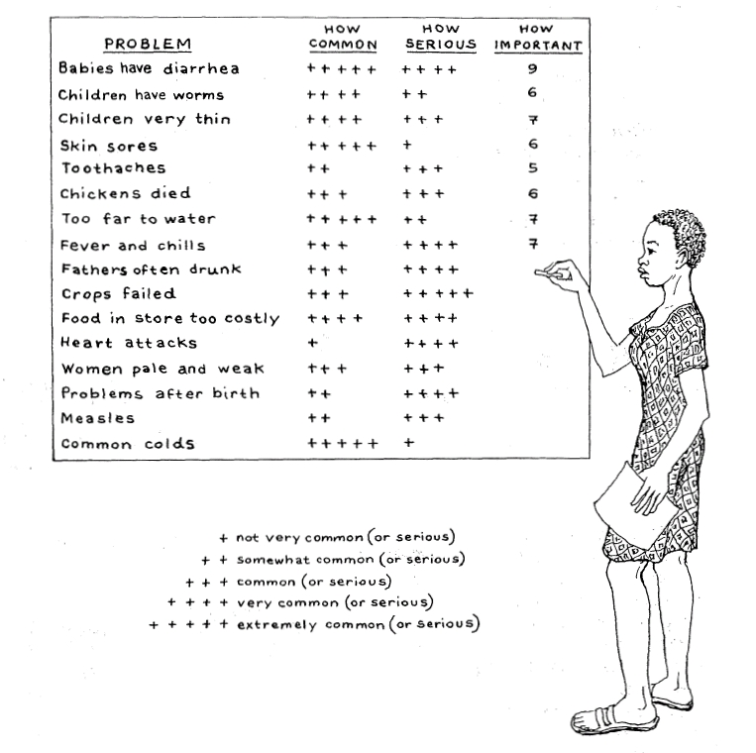

Slide 65
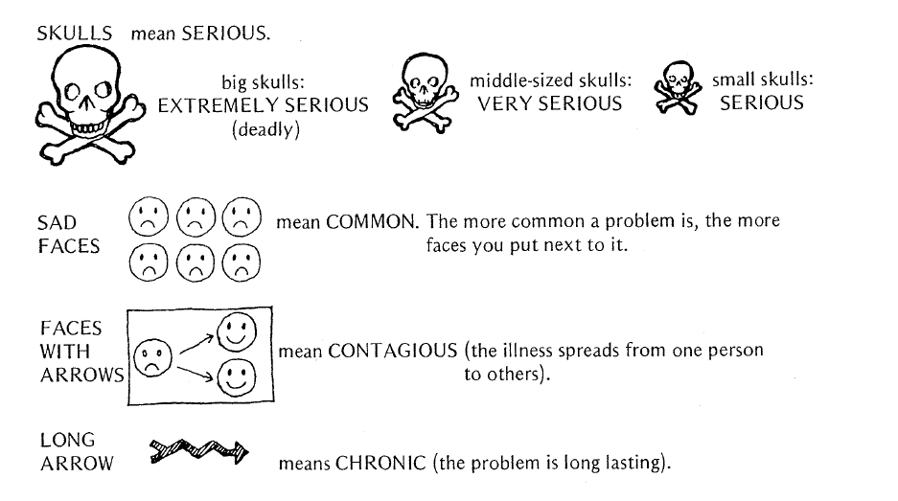

Slide 66
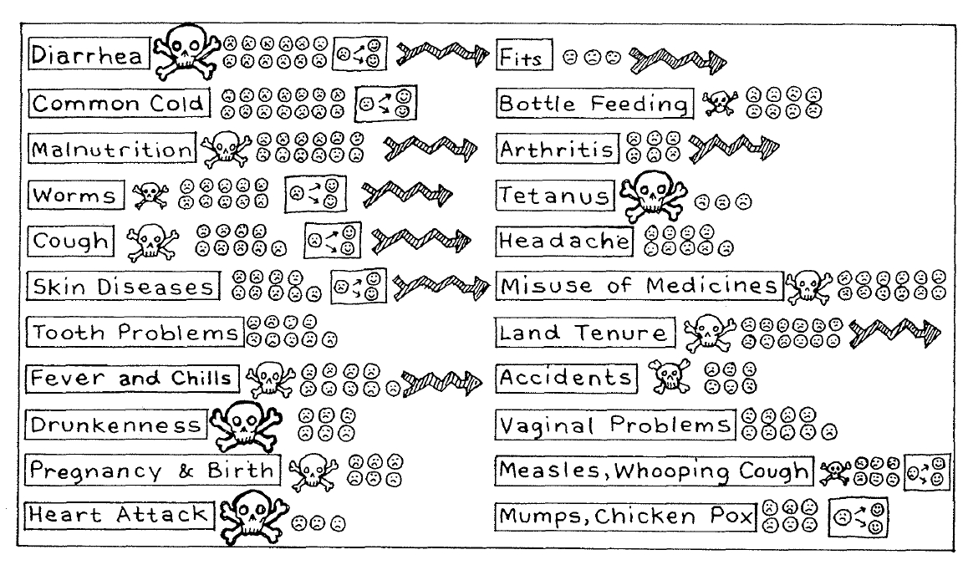

Slide 67
Participatory Methods
Ranking (cards)
Trend Analysis (calendar)
Mapping (access to resources, living patterns)
Transect walks
Diaries
Drawings
Photo-voice

Slide 68
Communicating
Group process writing
News releases
Fact sheets
Memos, flyers, brochures, & web-based reporting
Sharing information in real time
Participatory performance reporting
Visual displays: charts & graphs

Slide 69
Appreciative Inquiry
Fits with transformative paradigm because of emphasis on strengths in community experiences.
Asks about what is GOOD in the context.
Builds on what is good to vision of how things could be better.

Slide 70

Resources
Mertens, D. M. & Wilson, A. (in press). Program Evaluation. NY: Guilford.
Mertens, D. M. (2010). Research and evaluation in education and psychology: Integrating diversity with qual, quant and mixed methods. 3rd ed. Thousand Oaks, CA: Sage.
Mertens, D. M. (2009). Transformative research & evaluation. NY: Guilford
Mertens, D. M. & Ginsberg, P. (2009).(Eds.) Handbook of Social Research Ethics. Thousand Oaks, CA: Sage.

Slide 71
Contact information
Donna M. Mertens, Gallaudet University
    Donna.Mertens@Gallaudet.edu

